Slide 1
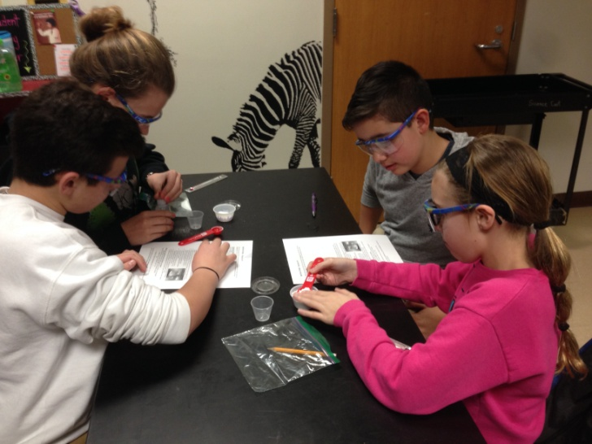
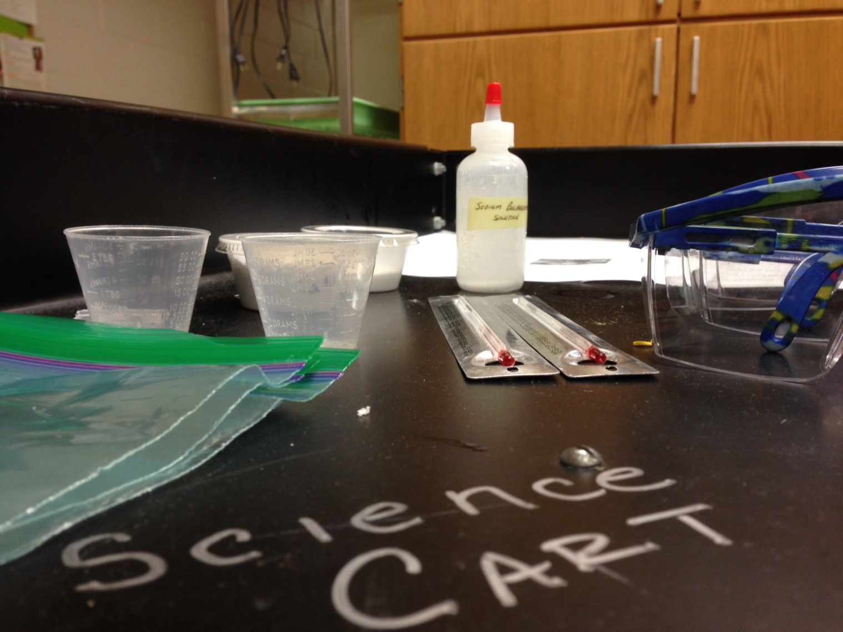
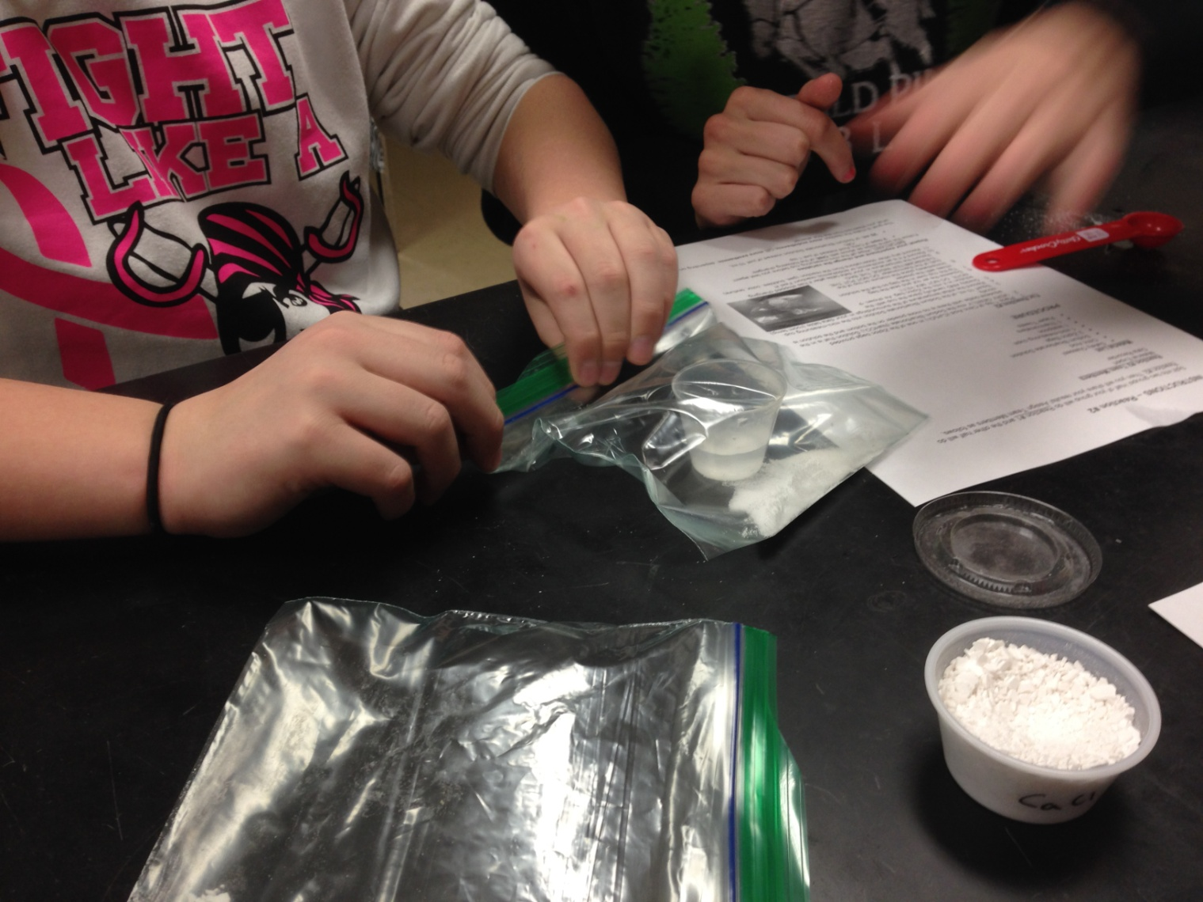
Application of Endothermic & Exothermic Reactions Logan Buck, COFSP Fellow Gray Middle School, 7th Grade Science, Ms. Ashley Gregory
RET is funded by the National Science Foundation, grant # EEC-1404766
Unit Overview
Activity Implementation
Student Work
Topic:
Thermal Energy Transfer through Chemical Reactions
Standards:
07-PS1-2. Analyze and interpret data on the properties of substances before and after the substances interact to determine if a chemical reaction has occurred.
07-PS1-6. Undertake a design project to construct test and modify a device that either releases or absorbs thermal energy by chemical processes.
PowerPoint on thermal energy transfer through chemical reactions: definitions, coal fired power plant illustration and reaction examples.
Groups of 4 worked on an endothermic and an exothermic reaction. They measured temperature changes and made observations.
Each group repeated the reactions and changed a single variable. The goal was to make the reaction more endothermic or exothermic.
In Reaction #2 - Trial 2 students doubled the amount of Citric Acid and the reaction became less endothermic! NaHCO3 solution was limiting.
In Reaction #1 - Trial 2 students doubled the amount of CaCl and the reaction became more exothermic! CaCl was limiting.
Activity Structure
Assessment Results:
Impact on Student Learning
Title:
Application of Endothermic & Exothermic Reactions
Guiding Questions:
What is an endothermic reaction? What is an exothermic reaction?
What are the characteristics of an endothermic reaction? Of an exothermic reaction?
What are some examples of chemical change? What are some examples of physical change?
What is the effect of concentration on the transfer of energy?
Are there other ways to improve the transfer of energy?
Objectives:
Define what endothermic and exothermic reactions are
Identify endothermic and exothermic reactions
Identify chemical vs. physical change
Recognize the effect of concentration on the transfer of energy
The results show an average increase in class average of 27%
However, the grades across the board were low due to personal inexperience in assessment question writing.
Students showed a much better understanding of endothermic and exothermic reactions, but were confused by questions that had options such as ‘(d) Both a & c’
Engineering Design Process
Class | 1 | 2 | 5 | 6 | 7 | Overall
Pre-Test | 52% | 42% | 54% | 49% | 41% | 47%
Post-Test | 64% | 65% | 67% | 70% | 59% | 65%
Percent Change | 19% | 35% | 19% | 30% | 30% | 27%
Students had to perform the reaction with a single variable change and
then determine
how the system
reacted.
Combine chemicals 1:1 ratio
Measure Temperature change
Combine chemicals 1:2 or 2:1 ratio
Measure temperature change
Record effect of variable change
Reflection and Conclusion
Pros | Cons
Implementation Class was attentive and polite Students were excited and provided encouraging feedback Ashley’s amazing class structure and ability to motivate her students! Students gained knowledge of the concept/content | Structure and wording of Pre- and Post-Assessment Time constraint An extra day would have allowed for a full cycle of the Engineering Design Process Not enough space for student creativity
Does a certain
variable change help or hinder the amount of thermal energy
absorbed/released
by the system?
Discussed use of endothermic and exothermic reactions in power plants, as well as in hot & cold packs!

